Slide 1
July 10, 2020
FEELME™ MUSIC&MOOD APP
Insights on You
from your Spotify Tracks
FEELME™ MUSIC&MOOD APP
BY JAZ VICCARRO,
DATA SCIENTIST, DEMOGRAPHER, MUSICIAN

Slide 2
Talking Points
Problem Statement
Analysis
Machine Learning Insights
Next Steps
Notes:
effectively to glean valuable insights in an effort to provide relevant recommendations to the customer.

Slide 3

SPOTIFY STREAMING DATA EXAMPLE USER PROFILE
John
Janeessan
1-YEAR WORTH OF DATA
over 30,000 streams tracked
EMOTIONAL PROFILE
Works in tech, Anxiety, Imposter Syndrome, dates online

Slide 4

Problem Statements
"CAN SPOTIFY Help me know myself better?"
"CAN THERE BE A WAY TO IMPROVE MY SPOTIFY RECOMMENDATIONS?“
“Does my music affect me on the daily?”
STREAMING

Slide 5

Analysis

Slide 6
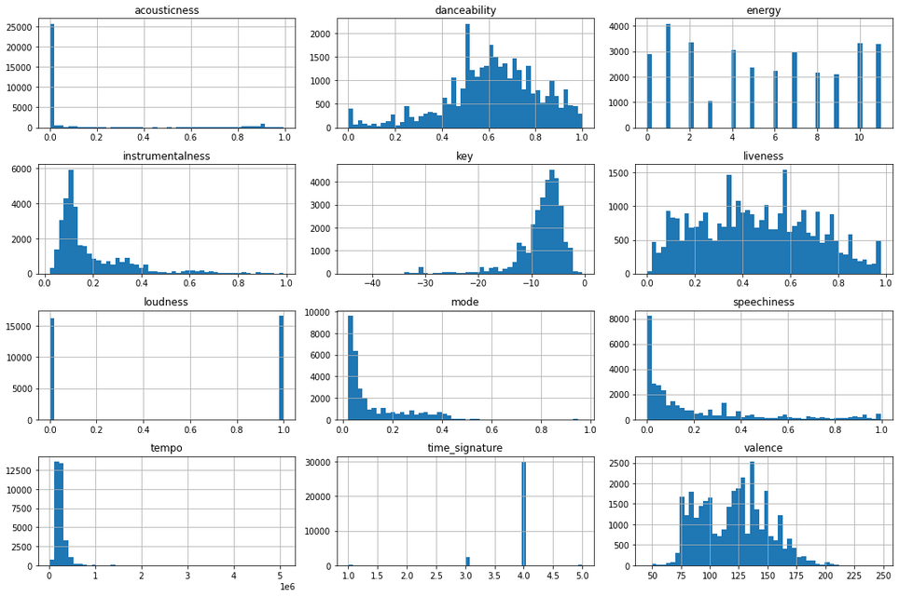
StreamingData
Notes:
Our most normalized features will provide best prospect at ML

Slide 7
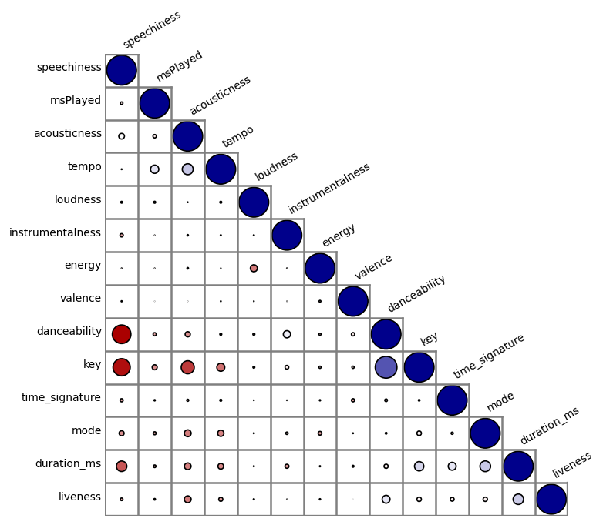
AudioFeatures
Blue: postive1:1
Red: negative 1:-1
Size: amount pos or neg correlated to
Relationships:
Speechiness
Danceability
Key
They must matter to the user!
Audio Features
Notes:
Here we have a correlation matrix depacting spatial as well as quantitative relationships. Here the diagonal of the matrix is the 1:1 relationship, from the diagonal straight down we see the distance from likeness

Slide 8
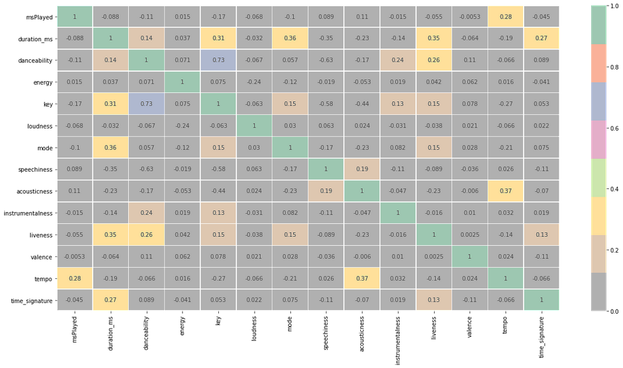
Audio Features – relationships hint at why users with niche preferences may be harder to service recommendations
Audio Features

Slide 9
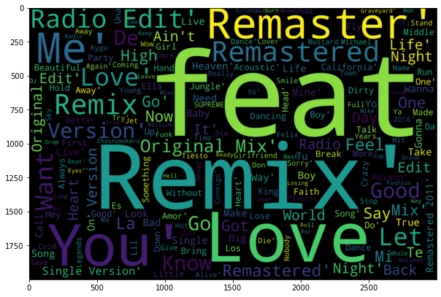
Track Names – hints at particularities; maybe be good for analyzing user behavior
Notes:
effectively to glean valuable insights in an effort to provide relevant recommendations to the customer.

Slide 10
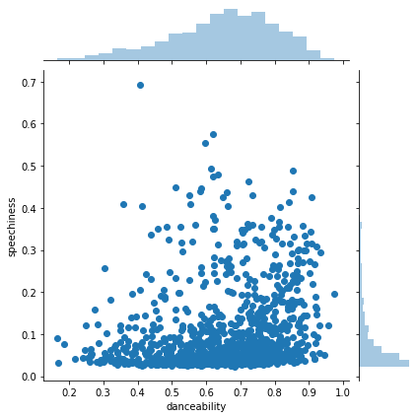
Speechiness & Danceability
“More speech equals less movement”
If speechiness; we need to add variety!
Notes:
effectively to glean valuable insights in an effort to provide relevant recommendations to the customer.

Slide 11

Machine Learning
Can ML give us good insights?
Supervised, Unsupervised, NLP methods

Slide 12

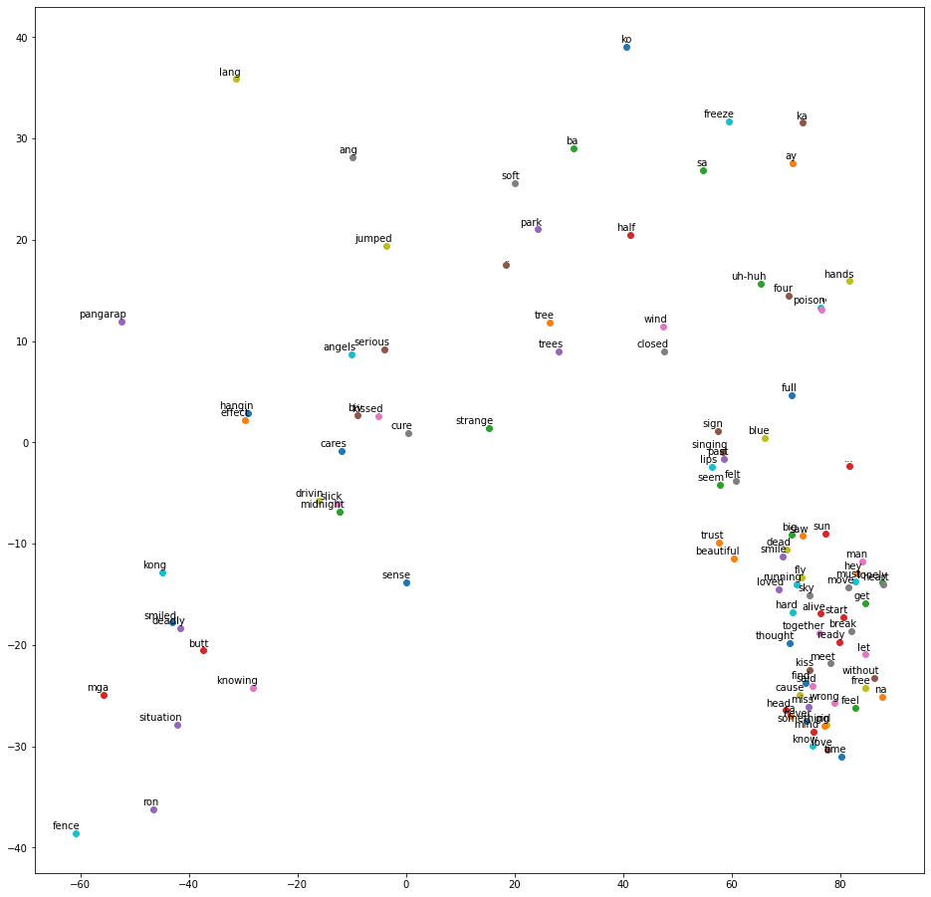


T
SNE
Notes:
Shows why user recommendations were difficult to fit to palette
Specifically, it models each high-dimensional object by a two- or three-dimensional point in such a way that similar objects are modeled by nearby points and dissimilar objects are modeled by distant points with high probability.

Slide 13
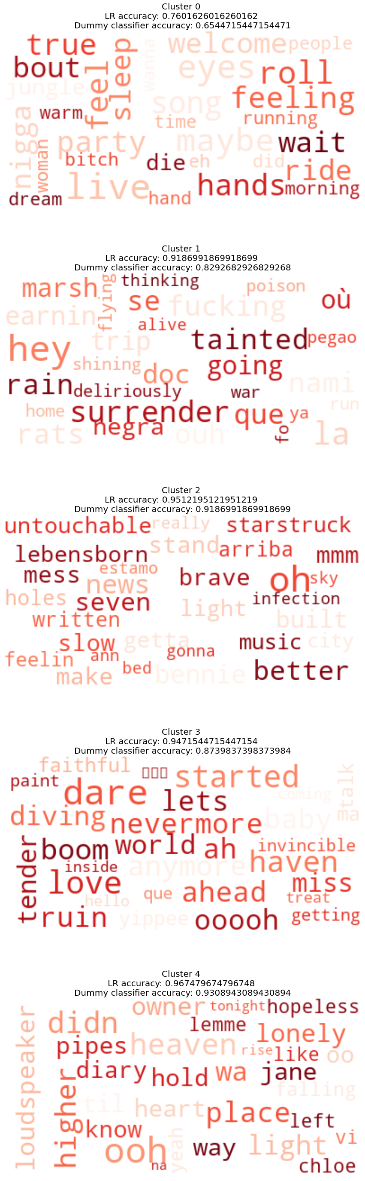
TFID + KMEANS + Logistic Regression Results
Cluster 0 :
Least accurate cluster
Largest membership
Cluster most “moody”
Notes:
Cluster accuracy may indicate veracity of insight pulled from the word sentiment

Slide 14
TFID + KMEANS + Logistic Regression Results
Cluster 1 :
2nd Largest membership
Cluster Mood “subversive”
Notes:
Cluster accuracy may indicate veracity of insight pulled from the word sentiment

Slide 15
TFID + KMEANS + Logistic Regression Results
Cluster 2 :
2nd lowest membership
Cluster Mood: “aspirational”
Notes:
Cluster accuracy may indicate veracity of insight pulled from the word sentiment

Slide 16
TFID + KMEANS + Logistic Regression Results
Cluster 3 : Cluster Mood: Yearning/ Nostaglic
Notes:
Cluster accuracy may indicate veracity of insight pulled from the word sentiment

Slide 17
Cluster 4 :
Most accurate cluster
Smallest Membership
TFID + KMEANS + Logistic Regression Results
Notes:
Cluster accuracy may indicate veracity of insight pulled from the word sentiment

Slide 18
Latent Dirichlet Allocation (LDA) Results/Topics:
Topic 0:
que la te el yo oh mi en lo se es tu por si tú ah los le eh una
Topic 1:
know don oh baby feel want love yeah way ve like just ll let come need home wanna night high
Topic 2:
love like don yeah just got know cause ll let ain say make baby wanna oh time want tell gonna
Topic 3:
sha ba na la da nami je le les du que suis dans pas est land hina bené pegao mafo
Topic 4:
oh ooh yeah dance got run don time hey let ma like uh ah woah just wee know gonna doo
Notes:
Cluster accuracy may indicate veracity of insight pulled from the word sentiment

Slide 19


NEXT STEPS
Neural Net training
Scale to API
Creating UX
Distribution

